Slide 1


Loops
Execute Blocks of Code Multiple Times
Doncho Minkov
Technical Trainer
http://minkov.it
Telerik Software Academy
http://academy.telerik.com

Slide 2

Table of Contents
What is a Loop?
Loops in JavaScript
while loops
do … while loops
for loops
Special loop operators
break, continue
Nested loops

Slide 3
What Is Loop?
A loop is a control statement that allows repeating execution of a block of statements
May execute a code block fixed number of times
May execute a code block while given condition holds
May execute a code block for each member of a collection
Loops that never end are called an infinite loops

Slide 4

Using while(…) Loop
Repeating a Statement While Given Condition Holds

Slide 5
How To Use While Loop?
The simplest and most frequently used loop
The repeat condition
Is not necessary true or false
Is evaluated to true or false
5, "strings",etc.. are evaluated as true
0, "", null are evaluated as false
Also called loop condition
while (condition)
{
statements;
}

Slide 6
While Loop – How It Works?
condition
false
true
statement

Slide 7
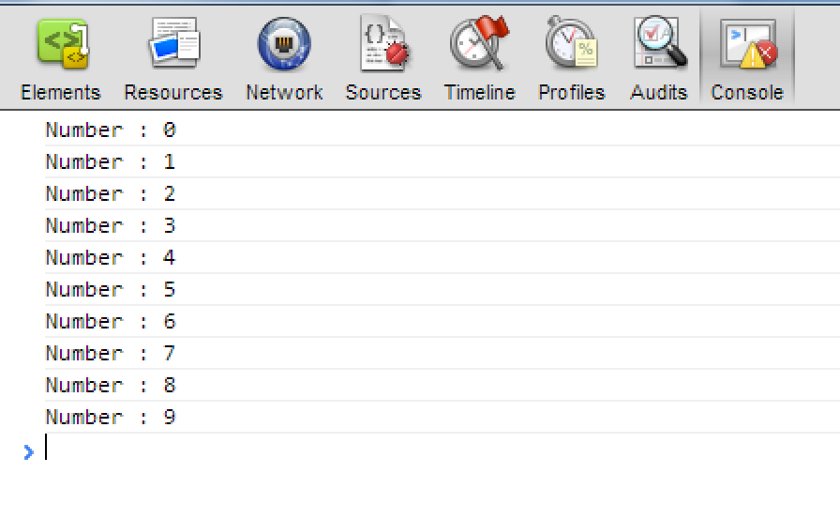
While Loop – Example
var counter = 0;
while (counter < 10)
{
console.log("Number : "+ counter);
counter++;
}

Slide 8

while(…)
Examples

Slide 9
Sum 1..N – Example
Calculate and print the sum of the first N natural numbers
var nStr = read("input-tb");
var n = parseInt(nStr);
var number = 1;
var sum = 1;
var result = "The sum 1";
while (number < n){
number++;
sum += number ;
result += "+" + number;
}
result += " = " + sum;
print("console-out",result);

Slide 10

Calculating Sum 1..N
Live Demo

Slide 11
Prime Number – Example
Checking whether a number is prime or not
var numberStr=read("input-tb");
var number = parseInt(numberStr);
var divider = 2;
var maxDivider = Math.sqrt(number);
var prime = true;
while (prime && (divider <= maxDivider)){
if (number % divider == 0){
prime = false;
}
divider++;
}
print("output-tb",prime);

Slide 12
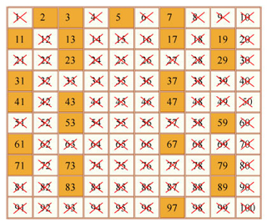
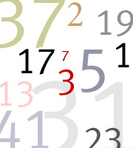
Checking Whether a Number Is Prime
Live Demo

Slide 13
Using break Operator
break operator exits the inner-most loop
var numberStr=read("input-tb");
var n = parseInt(numberStr);
var fact = 1;
var factStr = "n! = ";
while (true){
if (n == 1)
break;
factStr += n+ "*"
fact *= n;
n--;
}
factStr += "1 = " + fact;
print("output-tb",factStr);

Slide 14
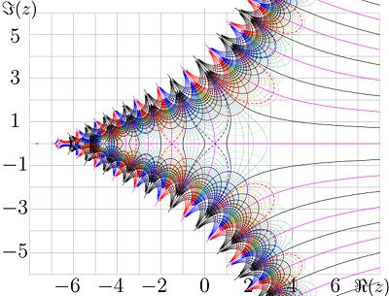
Calculating Factorial
Live Demo

Slide 15

do { … } while (…) Loop

Slide 16

Using Do-While Loop
Another loop structure is:
The block of statements is repeated
While the boolean loop condition holds
The loop is executed at least once
do
{
statements;
}
while (condition);

Slide 17
Do-While Statement
statement
true
condition
false

Slide 18

do { … } while (…)
Examples

Slide 19
Factorial – Example
Calculating N factorial
var fact = 1;
var factStr = "n! = ";
do{
fact *= n;
factStr += n+ "*"
n--;
} while (n > 0);
factStr += " = " + fact;
print("output-tb",factStr);

Slide 20
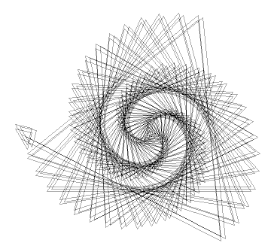
Factorial (do ... while)
Live Demo

Slide 21
Product[N..M] – Example
Calculating the product of all numbers in the interval [n..m]:
var number = n;
var product = 1;
var productStr = "";
do{
product *= number;
productStr +=number;
if(number!=m){
productStr+="*";
}
number++;
} while (number <= m);
productStr += " = " + product;
print("output-tb",productStr);

Slide 22
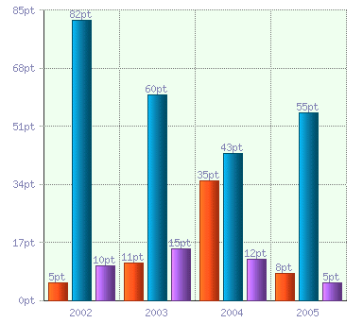
Product of the Numbers in the Interval [n..m]
Live Demo

Slide 23

for Loops

Slide 24
For Loops
The typical for loop syntax is:
Consists of
Initialization statement
Test expression that is evaluated to boolean
Update statement
Loop body block
for (initialization; test; update) { statements; }

Slide 25
The Initialization Expression
for (var number = 0; ...; ...) { // Can use number here } // Cannot use number here
Executed once, just before the loop is entered
Like it is out of the loop, before it
Usually used to declare a counter variable

Slide 26
The Test Expression
for (var number = 0; number < 10; ...) { // Can use number here } // Cannot use number here
Evaluated before each iteration of the loop
If true, the loop body is executed
If false, the loop body is skipped
Used as a loop condition

Slide 27
The Update Expression
for (var number = 0; number < 10; number++) { // Can use number here } // Cannot use number here
Executed at each iteration after the body of the loop is finished
Usually used to update the counter

Slide 28

for Loop
Examples

Slide 29
Simple for Loop – Example
A simple for-loop to print the numbers 0…9:
for (var number = 0; number < 10; number++)
{
console.log(number + " ");
}
A simple for-loop to calculate n!:
var factorial = 1;
for (var i = 1; i <= n; i++)
{
factorial *= i;
}

Slide 30
Complex for Loop – Example
Complex for-loops could have several counter variables:
for (var i=1, sum=1; i<=128; i=i*2, sum+=i)
{
console.log("i=" + i + ", sum=" +sum);
}
Result:
i=1, sum=1
i=2, sum=3
i=4, sum=7
i=8, sum=15
...

Slide 31

For Loops
Live Demo

Slide 32
N^M – Example
Calculating n to power m (denoted as n^m):
var result = 1;
for (var i=0; i<m; i++){
result *= n;
}
console.log(result);

Slide 33

Calculating N^M
Live Demo

Slide 34

Nested Loops
Using Loops Inside a Loop

Slide 35
What Is Nested Loop?
A composition of loops is called a nested loop
A loop inside another loop
Example:
for (initialization; test; update)
{
for (initialization; test; update)
{
statements;
}
…
}

Slide 36

Nested Loops
Examples

Slide 37
Triangle – Example
Print the following triangle:
1
1 2
…
1 2 3 ... n
var resultStr="";
for(var row = 1; row <= n; row++){
for(var column = 1; column <= row; column++){
resultStr += column + " ";
}
resultStr += "\n";
}
console.log(resultStr);

Slide 38

Triangle
Live Demo

Slide 39
Primes[N, M] – Example
Print all prime numbers in the interval [n, m]:
var result="";
for (var number = n; number <= m; number++){
var prime = true;
var divider = 2;
var maxDivider = Math.sqrt(number);
while (divider <= maxDivider){
if (number % divider == 0){
prime = false;
break;
}
divider++;
}
if (prime){
result += number+ " ";
}
}

Slide 40

Primes in Range [n, m]
Live Demo

Slide 41

Loops – More Examples

Slide 42
Nested Loops – Examples
Print all four digit numbers in format ABCD such that A+B = C+D (known as happy numbers)
Can you improve this algorithm to use 3 loops only?
for (var a =1 ; a <= 9; a++)
for (var b = 0; b <= 9; b++)
for (var c = 0; c <= 9; c++)
for (var d = 0; d <= 9; d++)
if (a + b == c + d)
console.log("{0}{1}{2}{3}",
a, b, c, d);
}

Slide 43

Happy Numbers
Live Demo

Slide 44
Nested Loops – Examples
Print all combinations from TOTO 6/49
Warning: execution of this code could take too long time.
var i1, i2, i3, i4, i5, i6;
for (i1 = 1; i1 <= 44; i1++)
for (i2 = i1 + 1; i2 <= 45; i2++)
for (i3 = i2 + 1; i3 <= 46; i3++)
for (i4 = i3 + 1; i4 <= 47; i4++)
for (i5 = i4 + 1; i5 <= 48; i5++)
for (i6 = i5 + 1; i6 <= 49; i6++)
console.log("{0} {1} {2} {3} {4} {5}",
i1, i2, i3, i4, i5, i6);

Slide 45
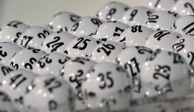
TOTO 6/49
Live Demo

Slide 46
for-in Loop
Iterating over the properties of object

Slide 47
for-in Loop
for-in loop iterates over the properties of an object
When the object is array, nodeList or liveNodeList for-in iterates over the elements
When the object is not an array, for-in iterates over its properties

Slide 48
for-in Loop (2)
Iterating over the elements of an array
Iterating over the properties of document
var arr = [1,2,3,4,5,6];
for(var index in arr){ console.log(arr[i])}
//1, 2, 3, 4, 5, 6
for(var prop in document){ console.log(document[prop])}
//http://localhost:64765/xxx%20for-in-loop.html
//function querySelector() { [native code] }
//function querySelectorAll() { [native code] }
//function evaluate() { [native code] }

Slide 49
for-in Loop
Live Demo

Slide 50


Loops
http://academy.telerik.com

Slide 51
Exercises
Write a script that prints all the numbers from 1 to N.
Write a script that prints all the numbers from 1 to N, that are not divisible by 3 and 7 at the same time.
Write a script that finds the max and min number from a sequence of numbers

